Slide 1
Data Structures And Algorithms
ELEMENTARY GRAPH ALGORITHMS
-Namrata Prasad
-181210032
-CSE 2nd Year

Slide 2
Topics Covered
Introduction
Elementary Graph Traversals : a) BFS- for Connected and Disconnected Graphs
b) DFS- for Connected and Disconnected Graphs
Cycle detection in a graph : a) Directed
b) Undirected
Minimum Spanning Trees : a) Kruskal's Algorithm
b) Prim's Algorithm
Shortest Path Algorithm : a) Single source shortest path
i) Dijkstra Algorithm
ii) Bellman Ford Algorithm
b) All source shortest path
iii) Floyd Warshall Algorithm

Slide 3


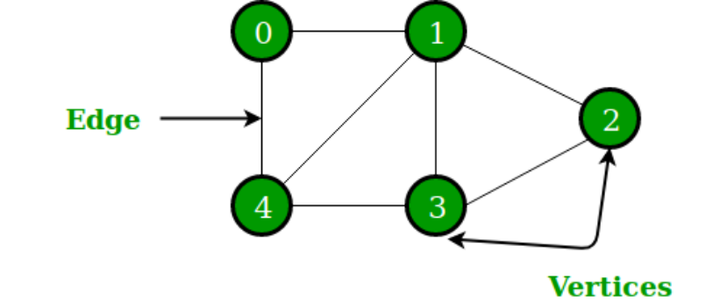
1. Introduction
Graph is a non-linear data structure that consists of a set of nodes (vertices) and a set of edges that relate the nodes to each other
A graph G is defined as :
G=(V,E)
where,
V(G): a finite, nonempty set of vertices
E(G): a set of edges (between pairs of vertices)
V={0,1,2,3,4}
E={(0,1)(1,2)(2,3)(3,4)(4,0)(1,4)(1,3)}

Slide 4
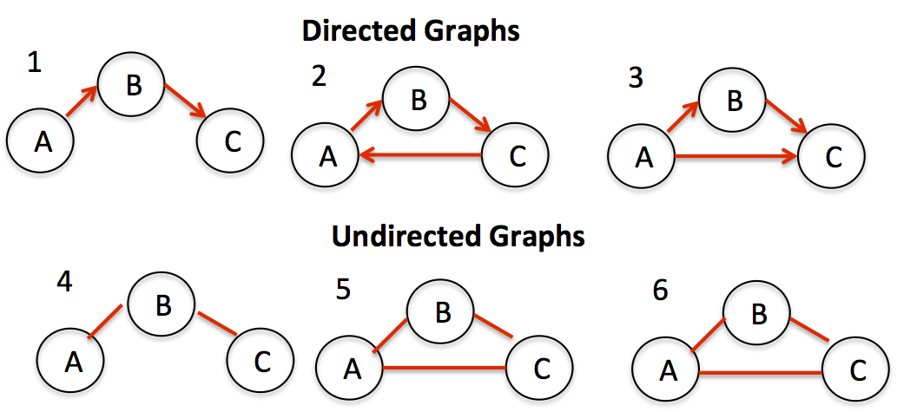
Directed Vs. Undirected Graphs
Undirected graph – all edges are undirected
Undirected edge has no orientation (no arrow head)
Directed graph – all edges are directed
Directed edge has an orientation (has an arrow head)
Note
Maximum number of edges in a directed graph is twice the maximum number of edges that can be present in an undirected graph.
Directed Graph : n*(n-1)
Undirected Graph : n*(n-1)/2

Slide 5
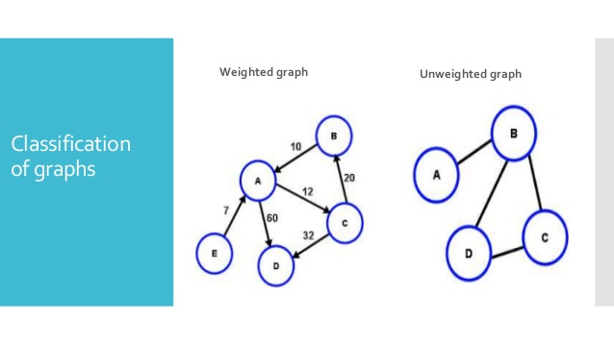
Weighted Graphs!
A weighted graph is a graph in which each branch is given a numerical weight. A weighted graph is therefore a special type of labeled graph in which the labels are numbers.
Note
In applications, the weight may be a measure of the length of a route, the capacity of a line, the energy required to move between locations along a route etc.

Slide 6
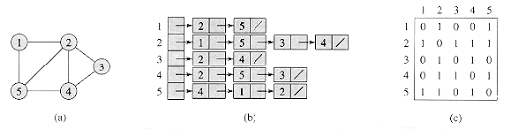
Representation
For graphs to be computationally useful, they have to be conveniently represented in programs. There are two representations of graphs:
Adjacency matrix representation
A square grid of size V×V, where
Aij = 1, if (i, j) ϵ E
0, otherwise
Adjacency lists representation
A graph of V nodes is represented by a one- dimensional array L of linked lists, where
> L[i] is the linked list containing all the nodes adjacent from node i.
> The nodes in the list L[i] are in no particular order

Slide 7
2. Graph Traversals
Graph traversal means visiting every vertex and edge exactly once in a well-defined order.The order in which the vertices are visited are important and may depend upon the algorithm used. There are mainly two algorithms used for graph traversals
Breadth-First Search Start several paths at a time, and advance in each one step at a time
Depth-First Search
Once a possible path is found, continue the search until the end of the path

Slide 8

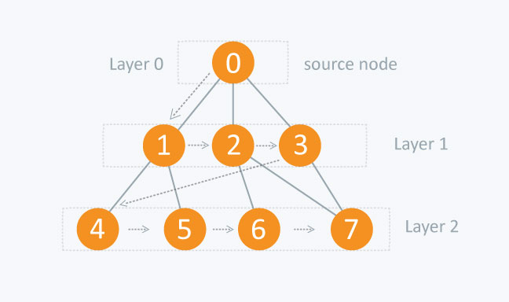
BREADTH FIRST SEARCH
BFS is a traversing algorithm where you should start traversing from a selected node (source or starting node) and traverse the graph layerwise thus exploring the neighbour nodes (nodes which are directly connected to source node). You must then move towards the next-level neighbour nodes.
As the name BFS suggests, you are required to traverse the graph breadthwise as follows:
First move horizontally and visit all the nodes of the current layer.
Move to the next layer.

Slide 9
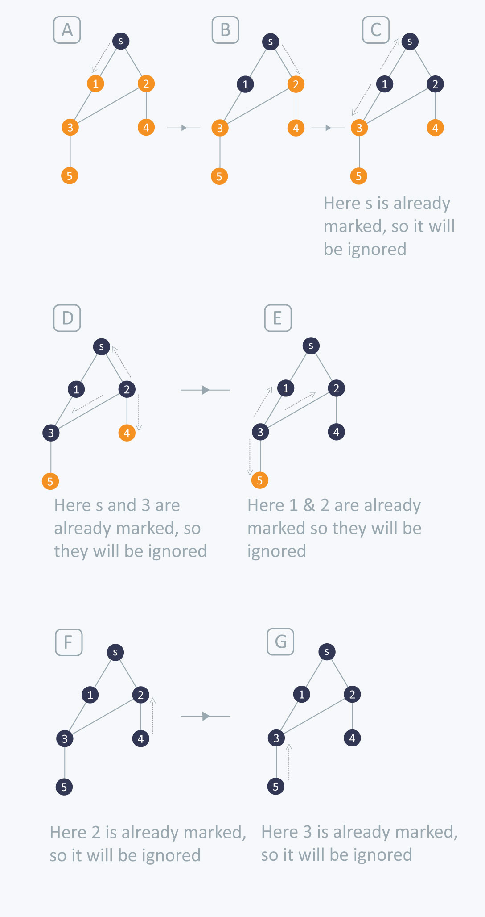
BFS ALGORITHM
BFS (G, s) //Where G is the graph and s is the source node
let Q be queue
Q.enqueue( s )
mark s as visited
while ( Q is not empty)
v = Q.dequeue( )
if w is not visited
Q.enqueue( w )
mark w as visited
//Inserting s in queue until all its neighbour vertices are marked.
//Removing that vertex from queue,whose neighbour will be visited now
// processing all the neighbours of v for all neighbours w of v in Graph G
//Stores w in Q to further visit its neighbour

Slide 10


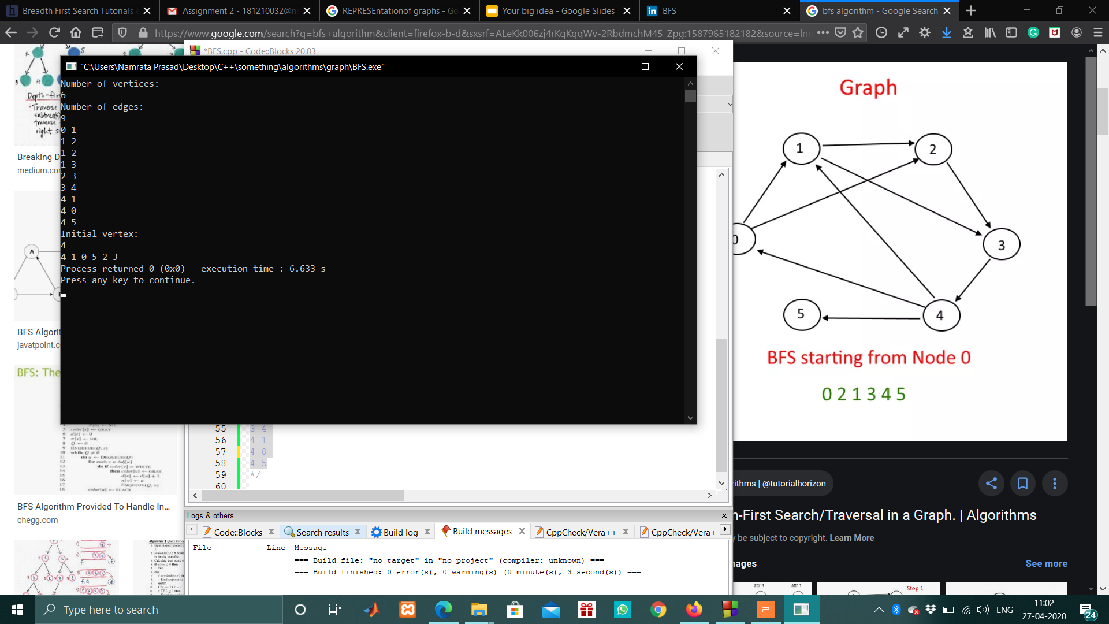
IMPLEMENTATION AND OUTPUTS

Slide 11
void BFSnode(int nodei,int visited[]) {
queue<int> myQ;
visited[nodei]=1;
myQ.push(nodei);
while(!myQ.empty() {
int node=myQ.front();
myQ.pop();
cout<<node<<" ";
for(auto i=vec[node].begin();i!=vec[node].end();i++)
if(visited[*i]==0) {
visited[*i]=1;
myQ.push(*i);
}
}
}
void BFS(int initial) {
int visited[V]={0};
BFSnode(initial,visited);
for(int i=0;i<V;i++)
if(visited[i]==0)
BFSnode(i,visited);
}
BFS for Disconnected Graphs
The array which keeps a track of all unvisited nodes present in the graph behaves differently.
After performing BFS for the initial node, we check if any vertices are left unvisited.
While(any unvisited vertex exists)
Perform BFS

Slide 12
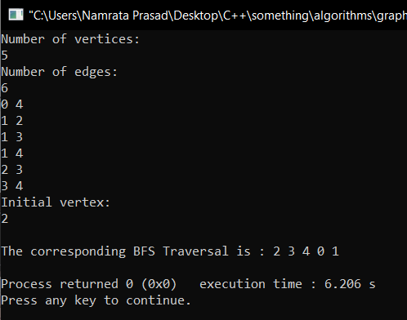
OUTPUTS

Slide 13
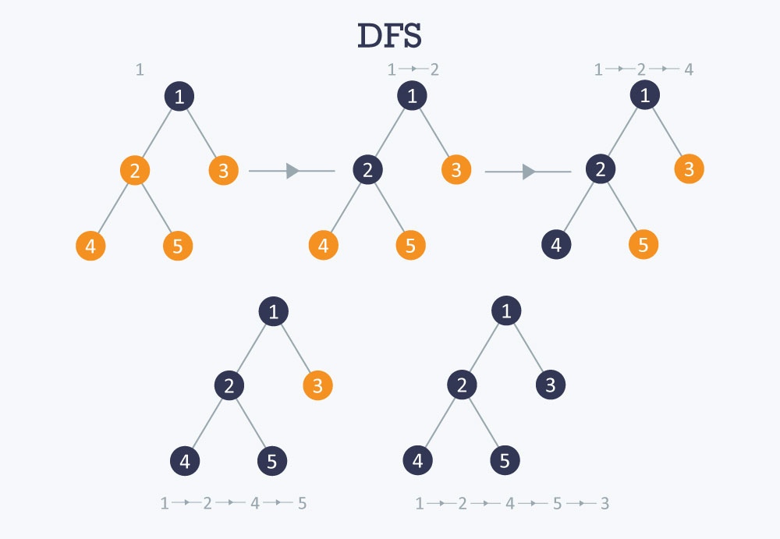
DEPTH FIRST SEARCH
The DFS algorithm is a recursive algorithm that uses the idea of backtracking.
Here, the word backtrack means that when you are moving forward and there are no more nodes along the current path, you move backwards on the same path to find nodes to traverse. All the nodes will be visited on the current path till all the unvisited nodes have been traversed after which the next path will be selected.

Slide 14
DFS ALGORITHM
The recursive nature of DFS can be implemented using stacks. The basic idea is as follows:
Pick a starting node and push all its adjacent nodes into a stack.
Pop a node from stack to select the next node to visit and push all its adjacent nodes into a stack.
Repeat this process until the stack is empty.
The same idea can also be implemented using simple recursion.
DFS-iterative (G, s): //Where G is graph and s is source vertex
let S be stack
S.push( s ) //Inserting s in stack
mark s as visited.
while ( S is not empty):
//Pop a vertex from stack to visit next
v = S.top( )
S.pop( )
//Push all the neighbours of v in stack that are not visited
for all neighbours w of v in Graph G:
if w is not visited :
S.push( w )
mark w as visited
DFS-recursive(G, s):
mark s as visited
for all neighbours w of s in Graph G:
if w is not visited:
DFS-recursive(G, w)

Slide 15
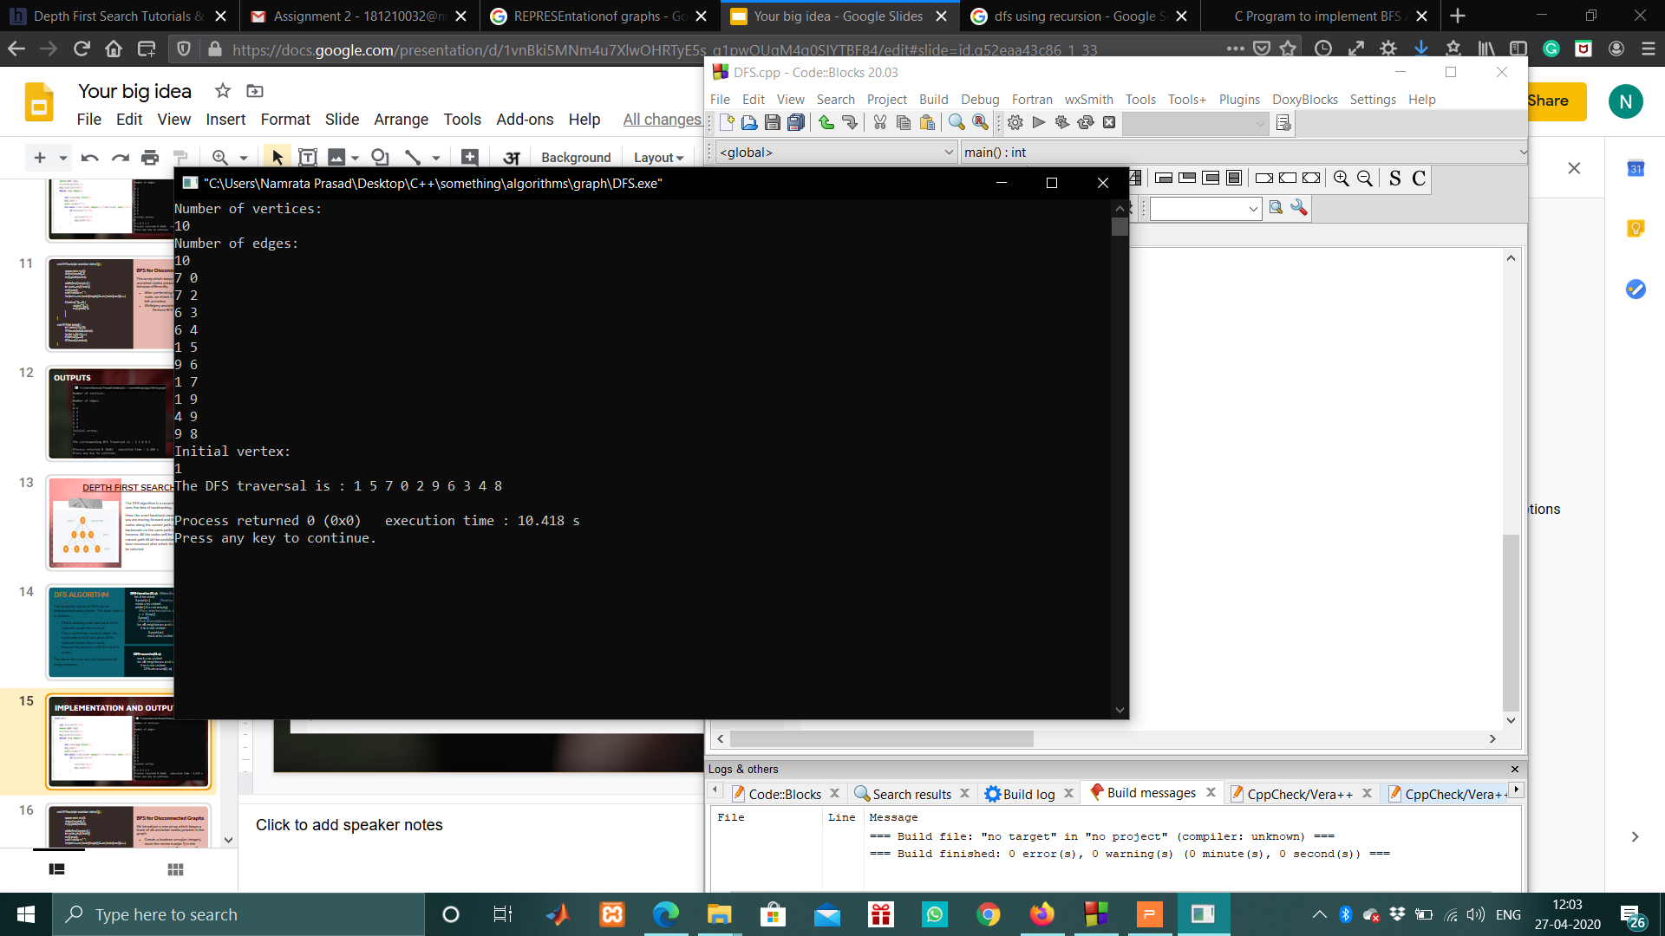

IMPLEMENTATION AND OUTPUTS

Slide 16
void DFSnode(int node, int visited[ ])
{
visited[node]=1;
cout<<node<<" ";
for(auto i=vec[node].begin(); i!=vec[node].end();i++)
if(visited[*i]==0)
DFSnode(*i,visited);
}
void DFS(int initial)
{
int visited[V]={0};
DFSnode(initial,visited);
for(int i=0;i<V;i++)
if(visited[i]==0)
DFSnode(i,visited);
}
DFS for Disconnected Graphs
Implementation of DFS for disconnected graphs is same as BFS.
The array which keeps a track of all unvisited nodes present in the graph behaves differently.
After performing DFS for the initial node, we check if any vertices are left unvisited.
While(any unvisited vertex exists)
Perform DFS

Slide 17
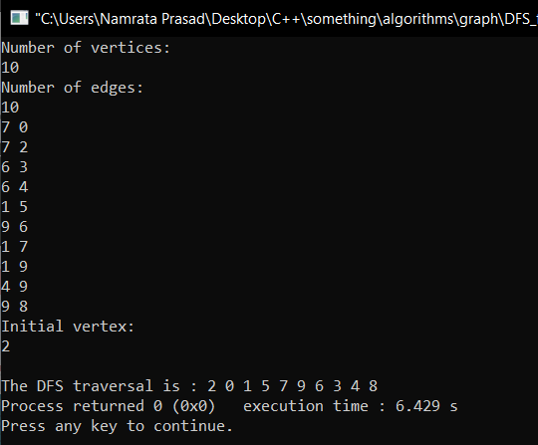
OUTPUTS

Slide 18
Cycle detection algorithms find out whether graph contains cycle or not. There are a lot of ways to detect a cycle in graphs like :
BFS
DFS
Union-Find(Disjoint Sets)
Union by Rank
Topological sort
etc...
3. Cycle Detection in Graphs

Slide 19
CYCLE DETECTION IN UNDIRECTED GRAPH USING DISJOINT SETS (UNION-FIND)
A disjoint-set is a data structure that keeps track of a set of elements partitioned into a number of disjoint (non-overlapping) subsets.
A union-find algorithm is an algorithm that performs two useful operations on such a data structure:
Find
Determine which subset a particular element is in. This can be used for determining if two elements are in the same subset.
Union
Join two subsets into a single subset.

Slide 20
ALGORITHM AND IMPLEMENTATION
Implementation
int V;
vector<int> *vec;
int *parent;
int Cycle()
{
parent=new int[V];
fill(parent,parent+V,-1);
int i=0;
while(i<V)
{
int x=findset(i);
for(int j=0;j<vec[i].size();j++)
{
int y=findset(vec[i][j]);
if(x==y)
return 1;
Union(x,y);
}
i++;
}
return 0;
}
Algorithm
Create a disjoint set for each vertex of the graph.
For every edge (u,v) in the graph:
Find root of the sets to which elements u and v belong
If both u and v have the same root in the disjoint set, a cycle is found.

Slide 21
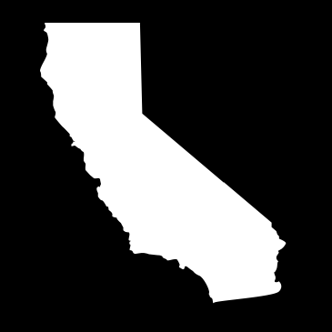
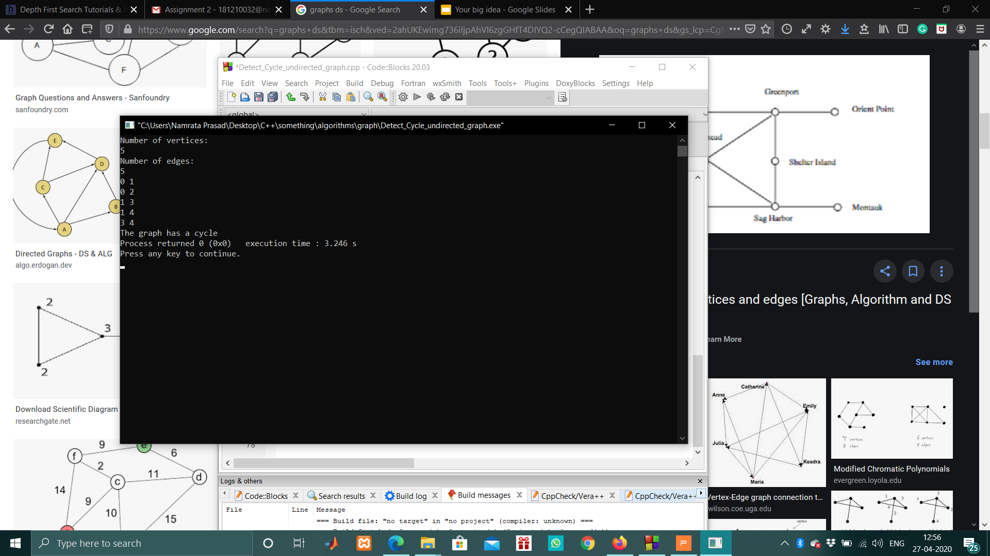
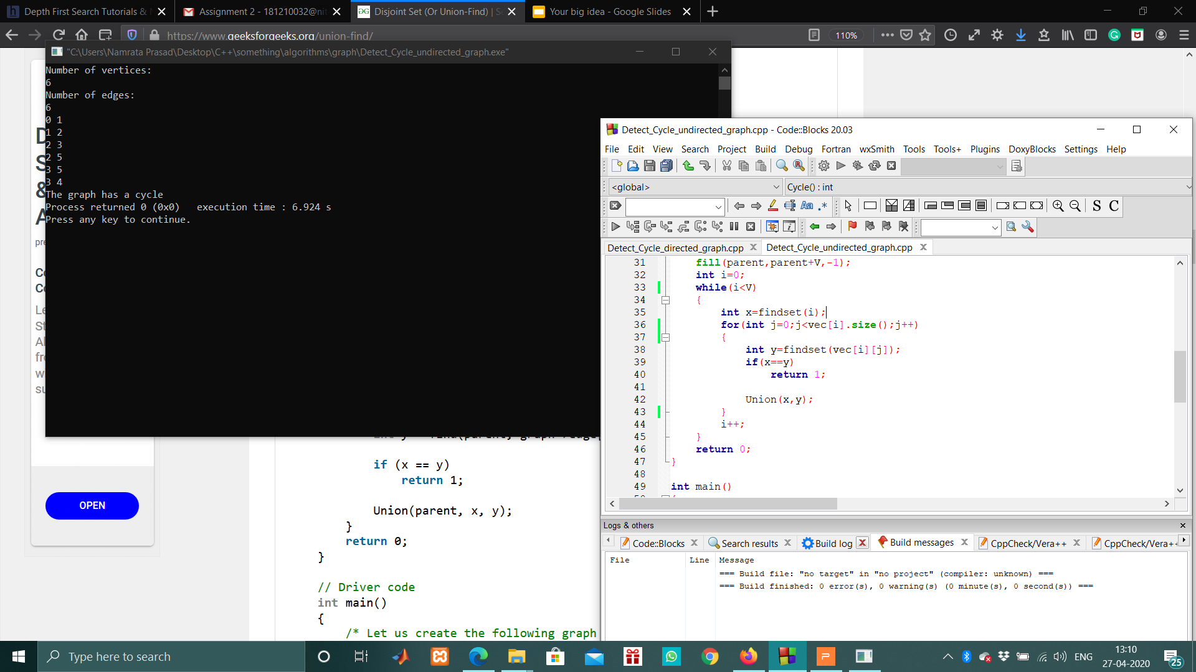
Outputs

Slide 22
CYCLE DETECTION IN DIRECTED GRAPH USING BFS
Steps involved in detecting cycle in a directed graph using BFS.
Step 1 : Compute in-degree for each of the vertex present in the graph and initialize the count of visited nodes as 0.
Step 2 : Pick all the vertices with in-degree as 0 and enqueue them into a queue
Step 3 : While queue is not empty:
Remove a vertex from the queue and then.
Increment count of visited nodes by 1.
Decrease in-degree by 1 for all its neighboring nodes.
If in-degree of a neighboring nodes is reduced to zero, then add it to the queue.
Step 4 : If count of visited nodes is not equal to the number of nodes in the graph has cycle, otherwise not.

Slide 23
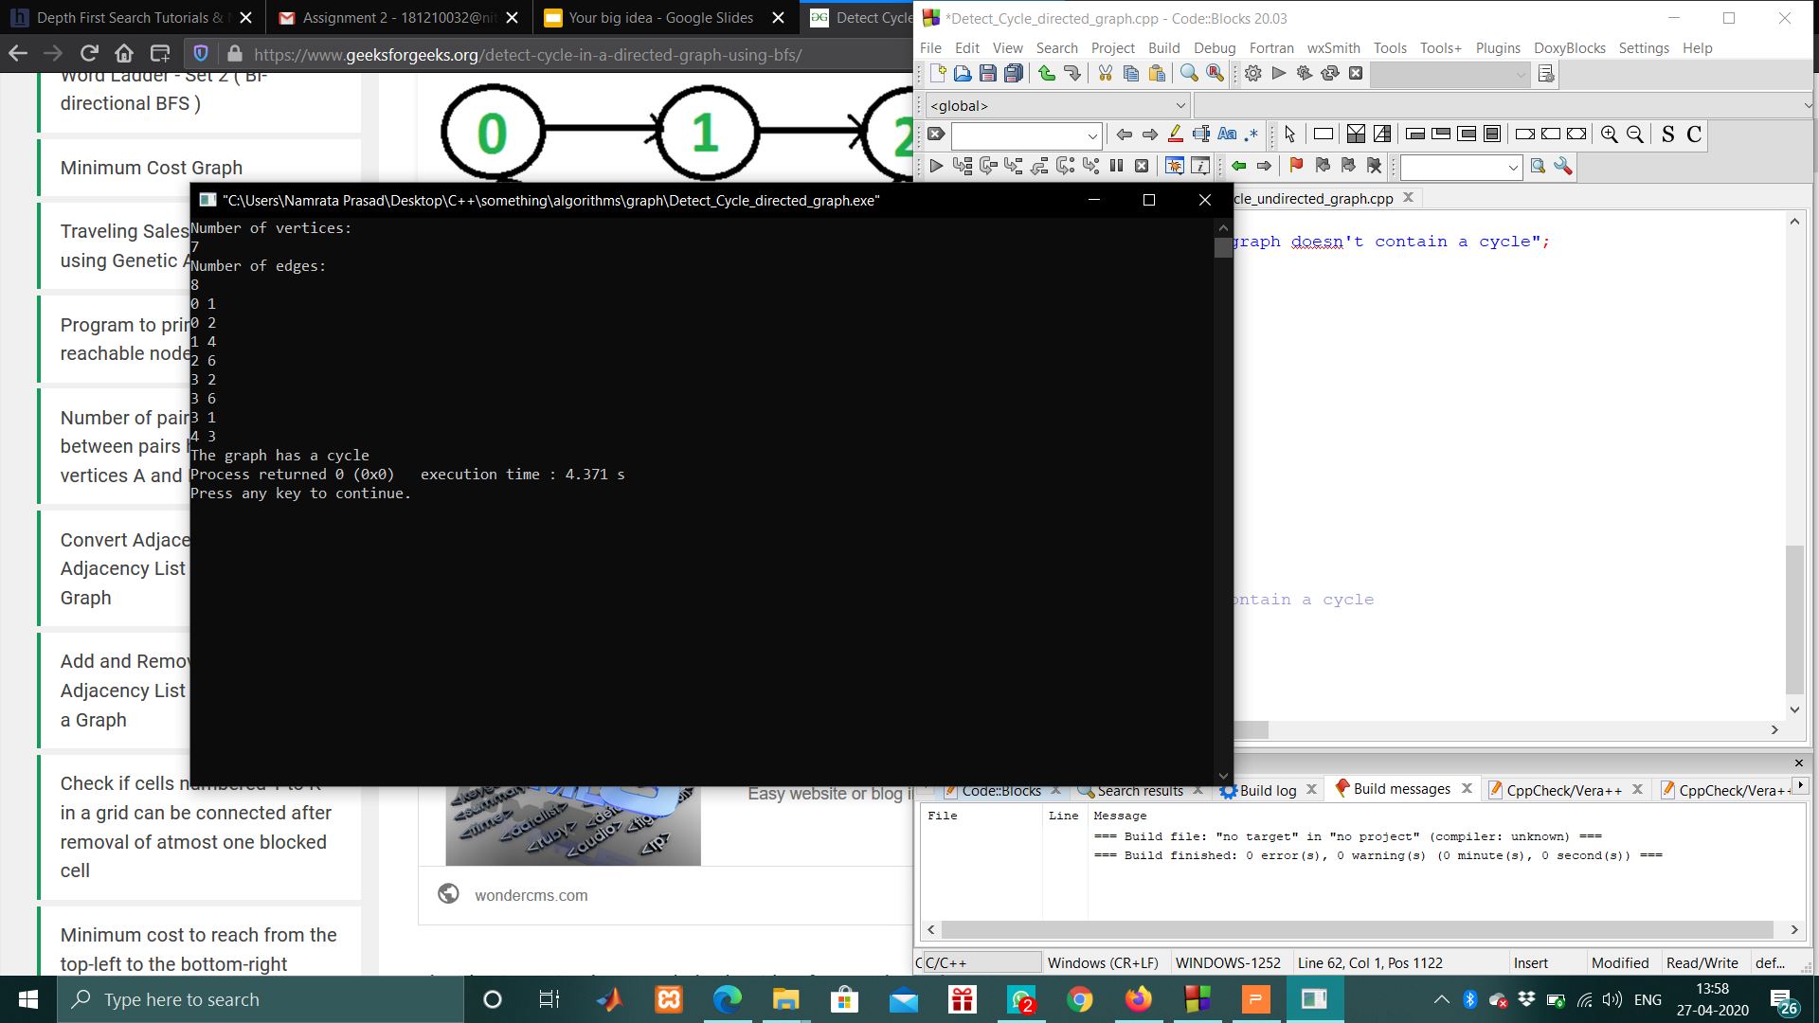
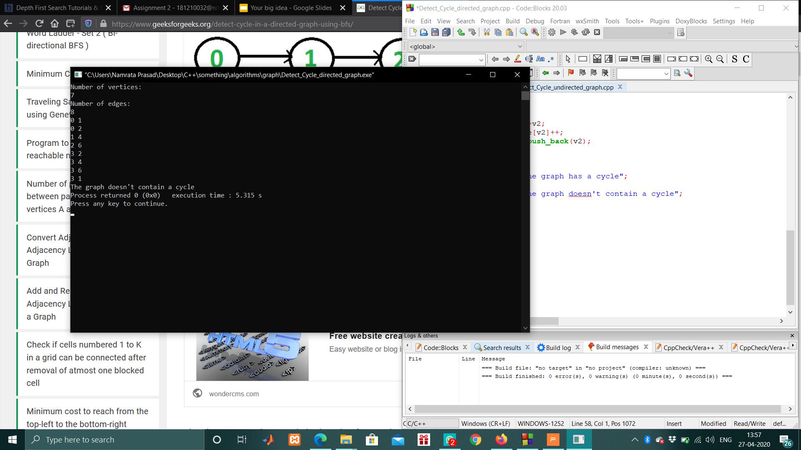
Implementation
int Cycle()
{
queue<int> myQ;
for(int i=0;i<V;i++)
if(in_degree[i]==0)
myQ.push(i);
int counts=0;
while(!myQ.empty())
{
int node=myQ.front();
myQ.pop();
for(auto i=vec[node].begin();i!=vec[node].end();i++)
if(--in_degree[*i]==0)
myQ.push(*i);
counts++;
}
if(counts==V)
return 0;
return 1;
}
Output

Slide 24
4. Minimum Spanning Tree
Spanning Tree
Given an undirected and connected graph G=(V,E), a spanning tree of the graph Gis a tree that spans G(that is, it includes every vertex of ) and is a subgraph of G
Minimum Spanning Tree
The cost of the spanning tree is the sum of the weights of all the edges in the tree.Minimum spanning tree is the spanning tree where the cost is minimum among all the spanning trees.
Total number of edges in a minimum spanning tree = |V|-1
Number of spanning trees that could be formed :
N = ^{|V|}C_{|E|}
In case the graph forms m cycles, number of spanning trees are:
N = ^{|V|}C_{|E|}-m

Slide 25
Theory
 | KRUSKAL’S ALGORITHM
Kruskal’s Algorithm builds the spanning tree by adding edges one by one into a growing spanning tree. Kruskal's algorithm follows greedy approach as in each iteration it finds an edge which has least weight and add it to the growing spanning tree.

Slide 26

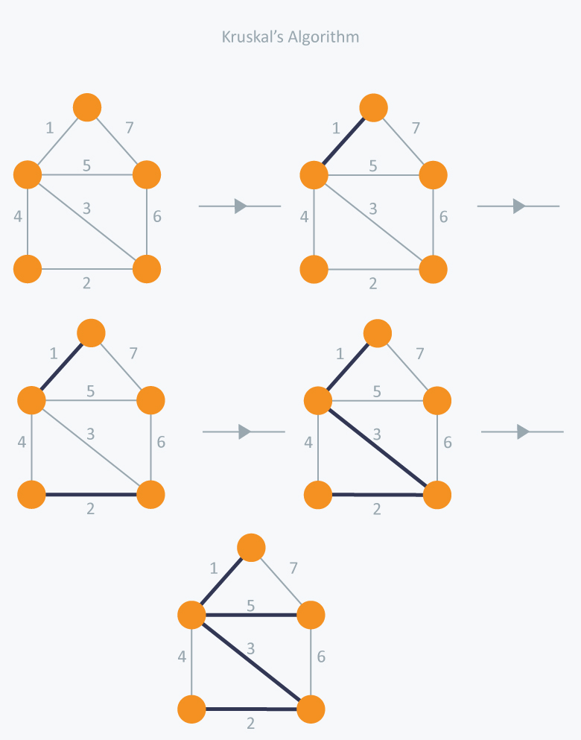
Algorithm
Sort the graph edges with respect to their weights.
Start adding edges to the MST from the edge with the smallest weight until the edge of the largest weight.
Only add edges which doesn't form a cycle , edges which connect only disconnected components.

Slide 27
Worst case time complexity of Kruskal’s Algorithm
= O(ElogV) or O(ElogE)
KRUSKAL(G):
A = ∅
For each vertex v ∈ G.V:
MAKE-SET(v)
For each edge (u, v) ∈ G.E ordered by increasing order by weight(u, v):
if FIND-SET(u) ≠ FIND-SET(v):
A = A ∪ {(u, v)}
UNION(u, v)
return A
PSEUDOCODE AND TIME COMPLEXITY
Time Complexity
Pseudocode

Slide 28
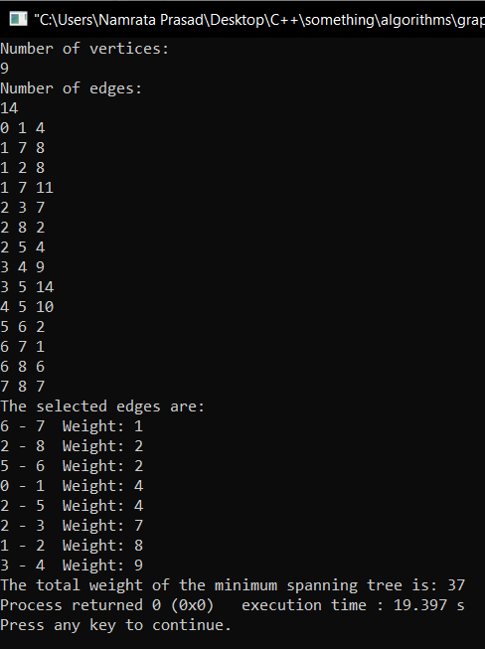
Implementation
typedef pair<int,int> edges;
int kruskalMST(vector<pair<int,edges> > vec)
{
int weight=0;
sort(vec.begin(),vec.end());
Disjointset d(V);
for(auto i=vec.begin();i!=vec.end();i++)
{
int set_u=d.findset(i->second.first);
int set_v=d.findset(i->second.second);
if(set_u!=set_v)
{
cout<<i->second.first<<" - "<<i->second.second<<" Weight: " <<i->first<<endl;
weight+=i->first;
d.Union(set_u,set_v);
}
}
return weight;
}
Output

Slide 29
Theory
 | PRIM’S ALGORITHM
Prim’s Algorithm also use Greedy approach to find the minimum spanning tree. In Prim’s Algorithm we grow the spanning tree from a starting position. Unlike an edge in Kruskal's, we add vertex to the growing spanning tree in Prim's.
At every step, it considers all the edges that are adjacent to the vertices already included in the MST and picks the minimum weight edge from these edges.

Slide 30
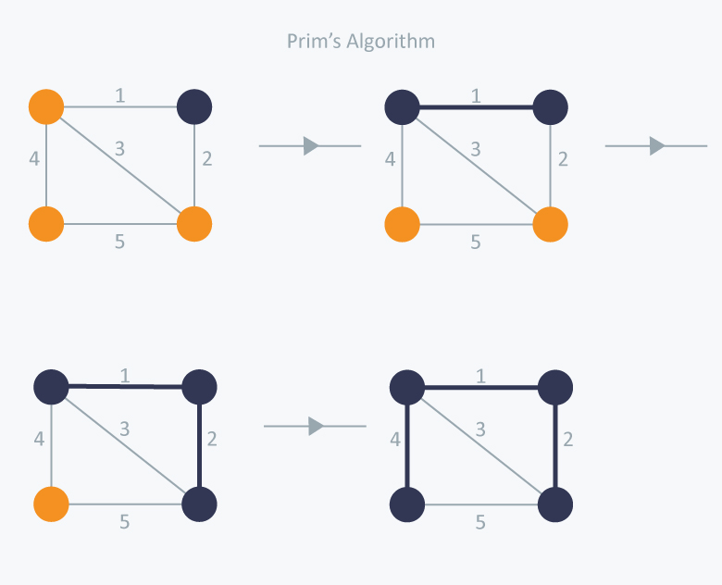
Algorithm
Create a set mst that keeps track of vertices already included in MST.
Assign a key value to all vertices in the input graph. Initialize all key values as INFINITE. Assign key value as 0 for the first vertex so that it is picked first.
While mst doesn’t include all vertices
Pick a vertex u which is not there in mst and has minimum key value.
Include u to mst.
Update key value of all adjacent vertices of u. To update the key values, iterate through all adjacent vertices. For every adjacent vertex v, if weight of edge u-v is less than the previous key value of v, update the key value as weight of u-v

Slide 31
Prim(G, w, s)
FOREACH (v∈V)
p[v] = NULL; d[v] = INF;
d[s] = 0
A=∅
S=∅
Q = PRIORITY-QUEUE(V, d) // used only to denote the cut
WHILE (!Q.EMPTY())
u = Q.EXTRACT-MIN() // pick the light edge = safe edge
S = S U {u} // add the current vertex to the other side of the cut
A = A U {(u, p[u])} // add the current edge to the partial MST
FOREACH (v∈Adj[u])
IF (d[v] > w(u,v)) // found a better edge from S to v
d[v] = w(u,v) // need to heapify-up the element!
// Q.DECREASE-KEY(v, w(u,v))
p[v] = u
RETURN A {(s, p(s))}
Worst case time complexity of Prim’s Algorithm
= O(V²)
It can be reduced to O(ElogE) by using adjacency lists.
PSEUDOCODE AND TIME COMPLEXITY
Time Complexity
Pseudocode

Slide 32
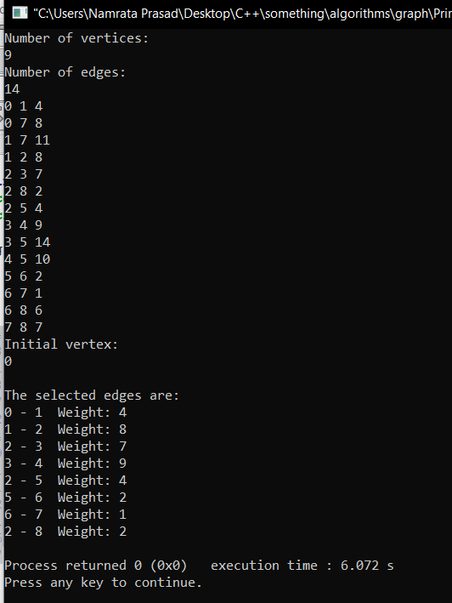
Implementation
typedef pair<int,int> edges;
void prim(int src){
vector<int> parent(V,-1);
vector<bool> mst(V,false);
vector<int> distance(V,INT_MAX);
distance[src]=0;
set<p> s;
s.insert({0,src});
while(!s.empty()) {
auto init=*s.begin();
int node=init.second;
mst[node]=true;
s.erase(s.begin());
for(auto &i : graph[node]){
int v=i.first;
int weight=i.second;
if(mst[v]==false && weight < distance[v]){
parent[v]=node;
distance[v]=weight;
s.insert({distance[v],v});
}
}
}
}
Output

Slide 33
5. SHORTEST PATH ALGORITHMS
In graph theory, the shortest path problem is the problem of finding a path between two vertices (or nodes) in a graph such that the sum of the weights of its constituent edges is minimized.
Some applications of shortest path algorithms are :
Traffic information systems use Dijkstra’s algorithm in order to track the destination from a given particular source.
Telephone Network
Flight Agenda
OSPF- Open Shortest Path First, used in Internet routing.

Slide 34
Single source and All source Shortest Paths
Single source shortest path problem computes length of the shortest path from the source to each of the remaining vertices in the graph.
Algorithms for single-source shortest path :
Dijkstra Algorithm
Bellman Ford Algorithm
The all-pairs shortest path problem finds the shortest paths between every pair of vertices u, v in the graph.
Algorithms for all-source shortest path :
Floyd Warshall Algorithm

Slide 35
Theory
 | DIJKSTRA’S ALGORITHM
This algorithm finds the path with lowest cost (i.e. the shortest path) between that vertex and every other vertex.
Works on both directed and undirected graphs. However, all edges must have nonnegative weights.
Approach: Greedy
Input: Weighted graph G={E,V} and source vertex, such that all edge weights are nonnegative
Output: Lengths of shortest paths (or the shortest paths themselves) from a given source vertex to all other vertices

Slide 36
Algorithm
This algorithm uses a set of pairs instead of priority queue as a set always stores the sorted order of elements.
Set all vertices distances = infinity except for the source vertex, set the source distance = 0.
Push the source vertex in a set of pairs in the form (distance , vertex), as the comparison in the set will be according to vertices distances.
Remove the first vertex from the set as it always gives the minimum weight edge (at first the popped vertex = source).
Update the distances of the connected vertices to the popped vertex in case of "current vertex distance + edge weight < next vertex distance", then push the vertex with the new distance to the set.
If the removed vertex is visited before, just continue without using it.
Apply the same algorithm again until the set is empty.

Slide 37
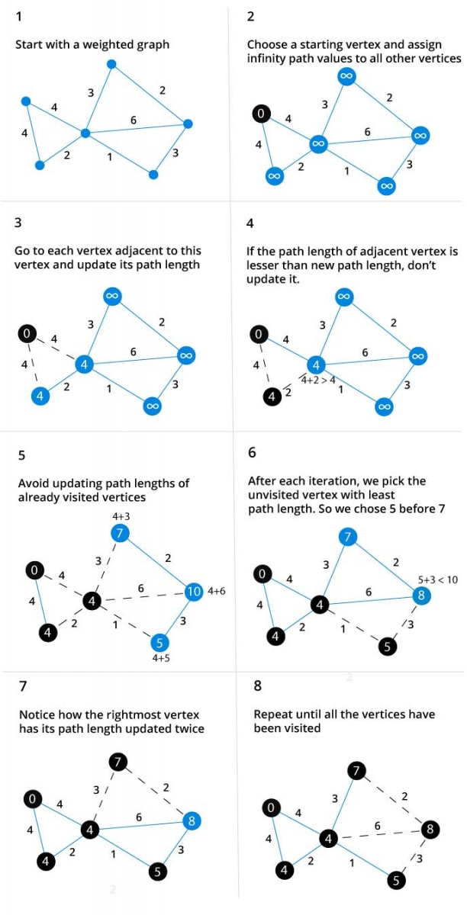

Slide 38
Time complexity of Dijkstra’s Algorithm
= O(V²)
but with sets or min-priority queue it drops down to . O(ElogE)
function dijkstra(G, S)
for each vertex V in G
distance[V] <- infinite
parent[V] <- NULL
If V != S, add V to Set of Pairs Q
distance[S] <- 0
while Q IS NOT EMPTY
U <- remove first element from Q
for each unvisited neighbour V of U
tempDistance <- distance[U] + edge_weight(U, V)
if tempDistance < distance[V]
distance[V] <- tempDistance
parent[V] <- U
return distance[ ], parent[ ]
PSEUDOCODE AND TIME COMPLEXITY
Time Complexity
Pseudocode

Slide 39
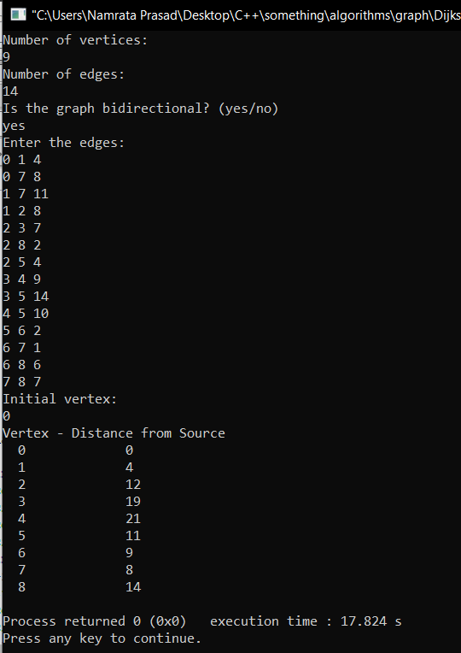
Implementation
void dijsktra(int src){
vector<int> distance(V,INT_MAX);
distance[src]=0;
set<pair<int,int>> s;
s.insert({0,src});
while(!s.empty())
{
auto init=*s.begin();
int node=init.second;
int dis=init.first;
s.erase(s.begin());
for(auto &i : graph[node]){
if(dis+i.second < distance[i.first]){
int dest= i.first;
auto f=s.find({distance[dest],dest});
if(f!=s.end())
s.erase(f);
distance[dest]=dis+i.second;
s.insert({distance[dest],dest});
}
}}}
Output

Slide 40
It is used in Google Maps
It is used in IP routing to find Open shortest Path First.
It is used in the telephone network.
It does blind search so wastes a lot of time while processing.
It cannot handle negative edges.
Advantages and Disadvantages
Advantages
Disadvantages

Slide 41
Theory
 | BELLMAN FORD ALGORITHM
Bellman Ford algorithm helps us find the shortest path from a vertex to all other vertices of a weighted graph.
It is similar to Dijkstra's algorithm but it can work with graphs in which edges can have negative weights.
Input: Weighted graph G={E,V} and source vertex
Output: Lengths of shortest paths (or the shortest paths themselves) from a given source vertex to all other vertices or an error message if a negative cycle is detected

Slide 42
Algorithm
Initialize distances from the source to all vertices as infinite and distance to the source itself as 0. Create an array dist[ ] of size |V| with all values as infinite except dist[src] where src is source vertex.
Calculate shortest distances. Do following |V|-1 times where |V| is the number of vertices in given graph.
Do following for each edge u-v
If dist[v] > dist[u] + weight of edge uv, then update dist[v]
dist[v] = dist[u] + weight of edge uv
Report if there is a negative weight cycle in graph.
Do following for each edge u-v
If dist[v] > dist[u] + weight of edge uv, then “Graph contains negative weight cycle

Slide 43
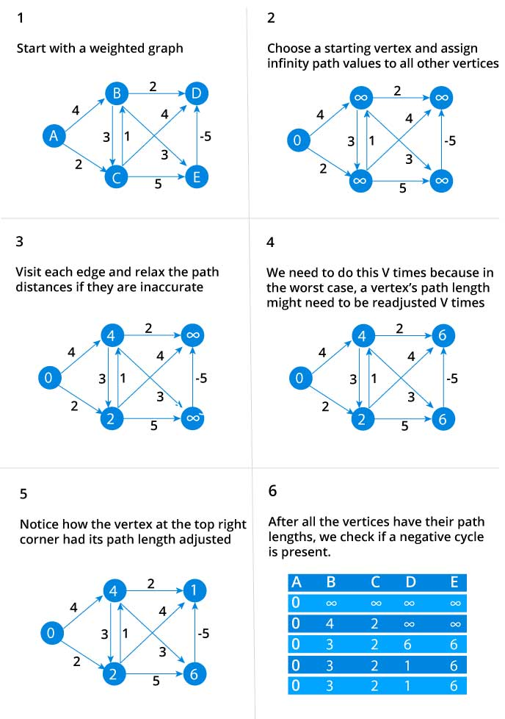

Slide 44
function bellmanFord(G, S)
for each vertex V in G
distance[V] <- infinite
parent[V] <- NULL
distance[S] <- 0
for each vertex V in G
for each edge (U,V) in G
tempDistance <- distance[U] + edge_weight(U, V)
if tempDistance < distance[V]
distance[V] <- tempDistance
parent[V] <- U
for each edge (U,V) in G
If distance[U] + edge_weight(U, V) < distance[V}
Error: Negative Cycle Exists
return distance[ ], parent[ ]
Time complexity of Bellman Ford’s Algorithm
= O(V*E)
PSEUDOCODE AND TIME COMPLEXITY
Pseudocode
Time Complexity

Slide 45
Implementation
void bellmanFord(int src){
vector<int> distance;
for(int i=0;i<V;i++)
distance.push_back(INT_MAX);
distance[src]=0;
for(int i=0;i<V-1;i++)
{
bool update=false;
for(auto i : graph){
int u=i.first;
for(auto j : i.second){
int v=j.first;
int dis=j.second;
if(distance[u] != INT_MAX && dis+distance[u] < distance[v])
{update=true;
distance[v]=dis+distance[u];}
}
}
if(update==false)
break;
}
for(int i=0;i<e;i++){
for(auto i : graph){
int u=i.first;
for(auto j : i.second){
int v=j.first;
int dis=j.second;
if(distance[u] != INT_MAX && dis+distance[u] < distance[v])
{cout<<"Negative Cycle Detected!!"<<endl;
return;}
}
}
}
cout<<"Vertex - Distance from Source"<<endl;
for(int i=0;i<V;i++)
cout<<" "<<i<<"\t\t"<<distance[i]<<endl;
}

Slide 46
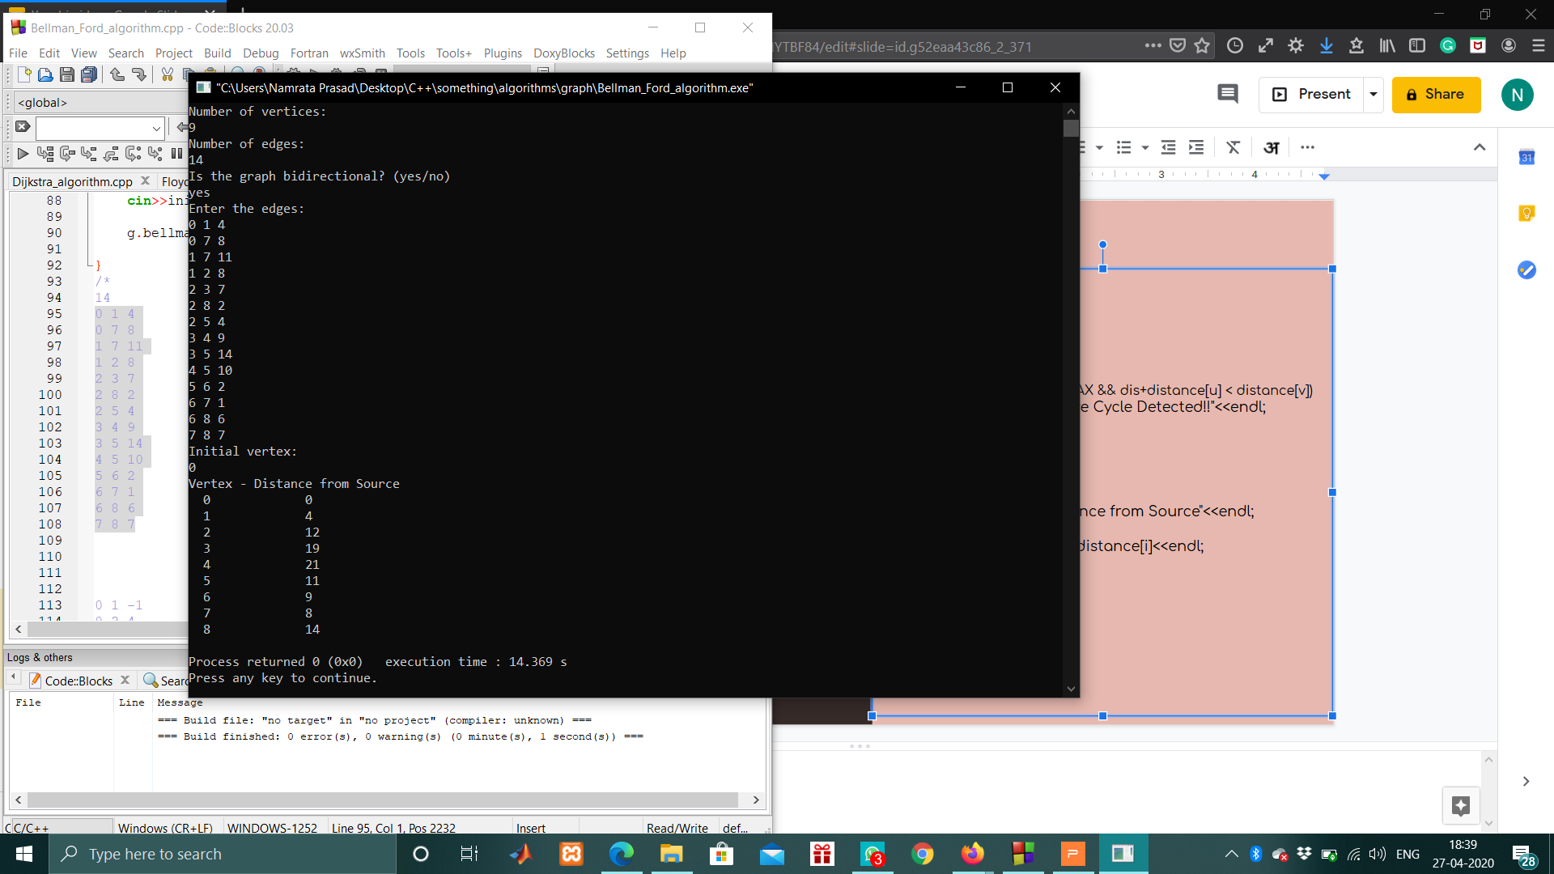
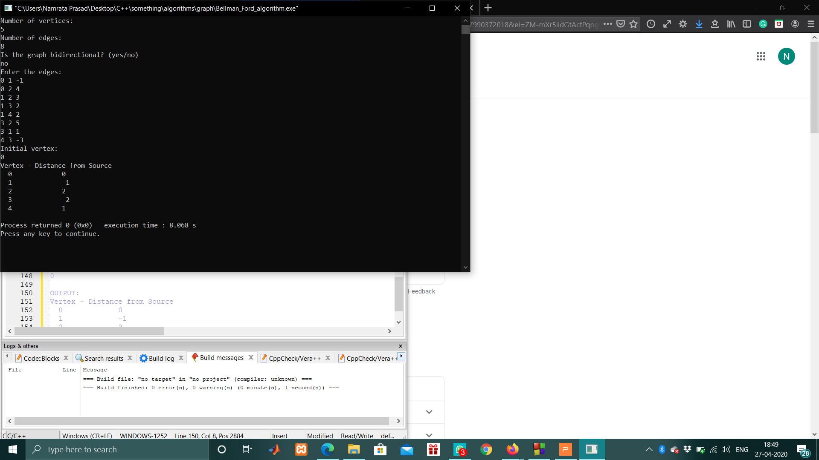
Outputs

Slide 47
Theory
 | FLOYD WARSHALL ALGORITHM
Floyd–Warshall's Algorithm is used to find the shortest paths between between all pairs of vertices in a graph, where each edge in the graph has a weight which is positive or negative.
Approach: Dynamic Programming
Input: Adjacency matrix representation of weighted graph G={E,V} and source vertex
Output: An adjacency matrix containing lengths of shortest paths from all vertices to all other vertices or an error message if a negative cycle is detected

Slide 48
Algorithm
Initialize the shortest paths between any 2 vertices with Infinity.
Find all pair shortest paths that use 0 intermediate vertices, then find the shortest paths that use 1 intermediate vertex and so on.. until using all N vertices as intermediate nodes.
Minimize the shortest paths between any 2 pairs in the previous operation.
For any 2 vertices ( i, j ), one should actually minimize the distances between this pair using the first K nodes, so the shortest path will be:
min(dist[ i ][ k ] +dist[ k ][ j ] , dist[ i ][ j ]

Slide 49
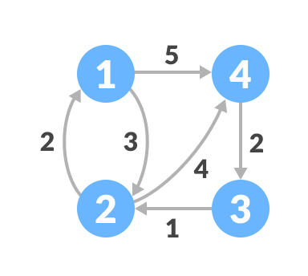
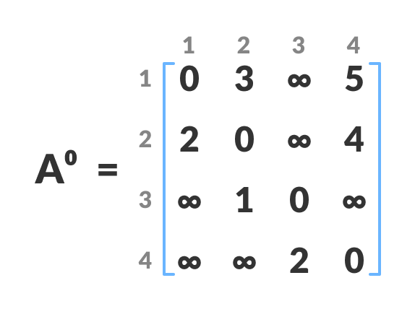
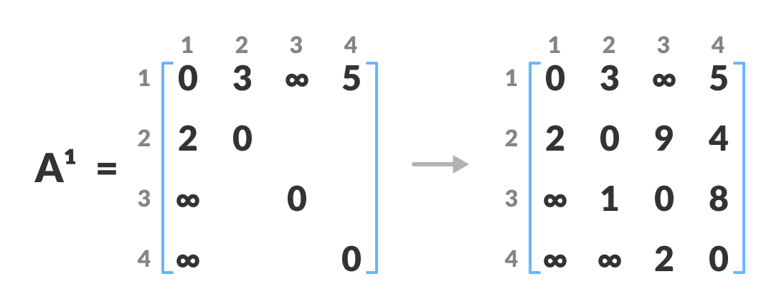
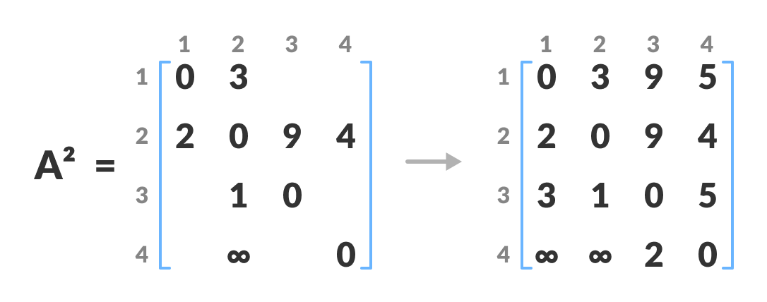
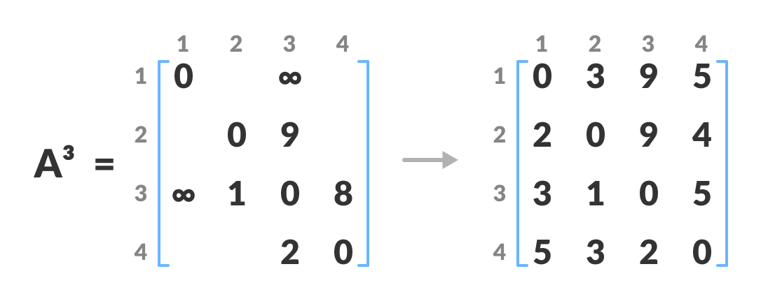
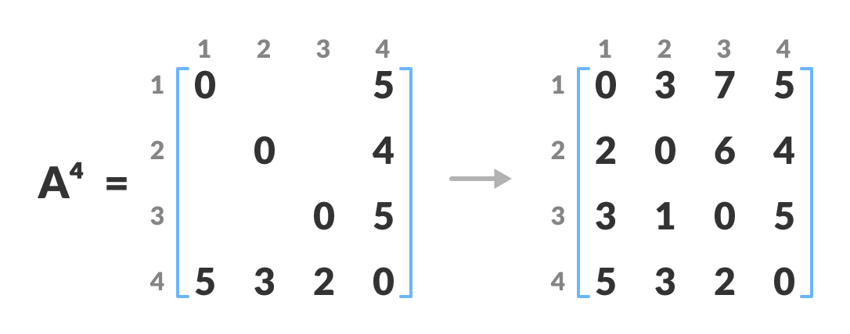

Slide 50
function FloydWarshall(G, S)
n = no of vertices
A = matrix of dimension n*n
for k = 1 to n
for i = 1 to n
for j = 1 to n
A^{k}[i, j] = min (A^{k-1}[i, j], A^{k-1}[i, k] + A^{k-1}[k, j])
return A
Time complexity of Bellman Ford’s Algorithm
= O(V*E)
PSEUDOCODE AND TIME COMPLEXITY
Time Complexity
Pseudocode

Slide 51
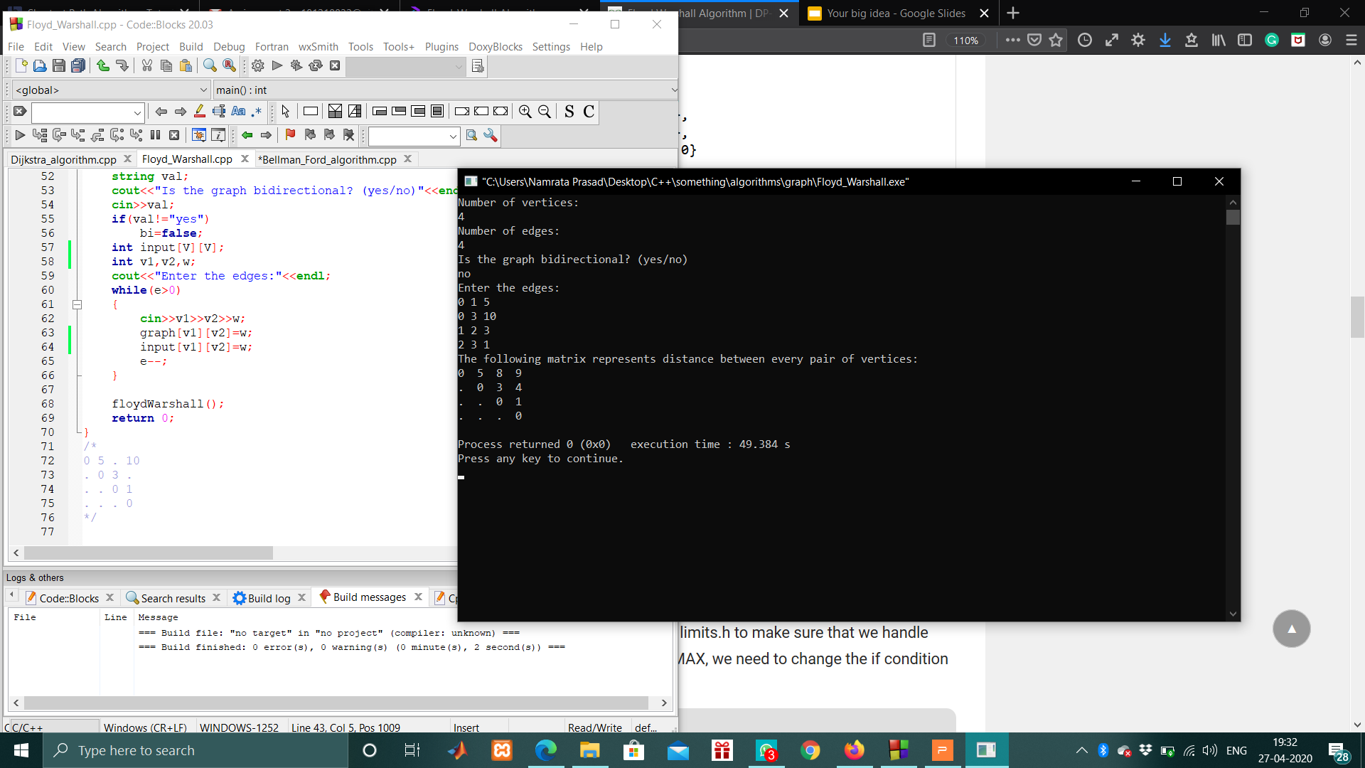
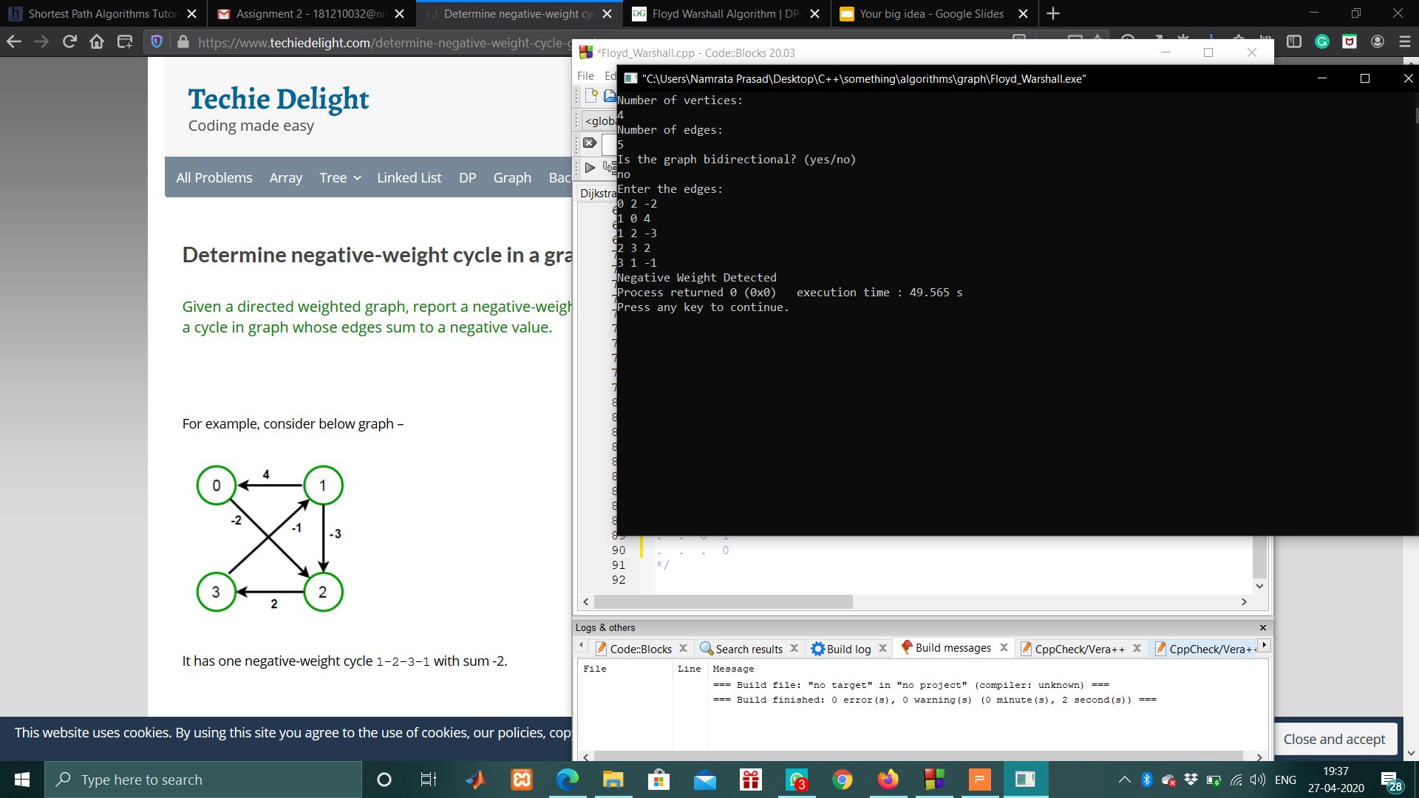
Implementation
void floydWarshall( ){
//Floyd Warshall Algorithm
for(int k=0;k<V;k++)
for(int i=0;i<V;i++){
for(int j=0;j<V;j++)
Graph[ i ][ j ] = min(graph[ i ][ j ] ,graph[ i ][ k]+graph[k][j]);
//If any of the diagonals become negative, it means the
//graph has a negative cycle
if(graph[i][i]<0)
{
cout<<"Negative Weight Detected";
return;
}
}
}
Output

Slide 52
Thank you!!

